Slide 1
FIFA WORLD CUP Analysis
​FIZA FAHAMEEN M

Slide 2
Introduction
Analyzing the FIFA World Cup dataset offers us a unique opportunity to unearth hidden insights and unlock the secrets of football's greatest spectacle. Beyond the exhilarating moments on the pitch lies a treasure trove of information that can provide us with invaluable perspectives on team strategies, player performances, historical trends, and the ever-evolving landscape of the beautiful game.

Slide 3
DATASETS:- WorldCupMatches worldcupplayers worldcups
“
”

Slide 4
PRIMARY GOALS
we'll navigate through decades of matches, goals, assists, and championships, unraveling the stories that have shaped the course of football history.
Analyzing the Winners, Runner-up and Third Place
Goals by Each Team by their Performance
Attendance Per Year
Attendance per year indicates the average number of spectators who attend FIFA World Cup matches annually. It reflects the tournament's popularity, growth trends, host country influence, key match identification, and comparative analysis across editions. This metric is vital for understanding the tournament's success and impact on a global scale.

Slide 5
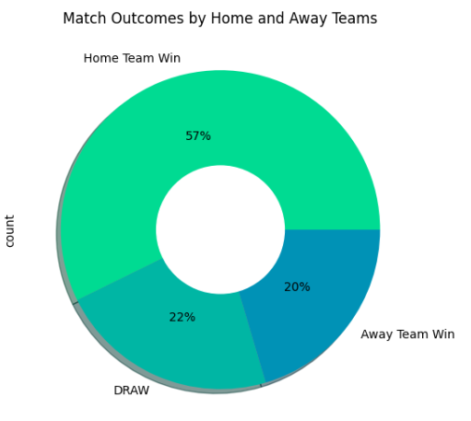
AREAS OF GROWTH
- Home teams significantly increase their chances of success during the FIFA World Cup when playing on their home ground.
- Statistics indicate that home teams win approximately 57% of the time, showcasing a substantial advantage.
- Draw matches occur in 22% of games played by home teams, indicating a relatively common outcome.
- Losses are infrequent for home teams, with only a 20% chance of losing a match on their home soil.
- These figures underscore the undeniable influence of home-ground advantage in World Cup matches, emphasizing the significance of familiar surroundings, local support, and potential psychological factors in determining match outcomes.

Slide 6
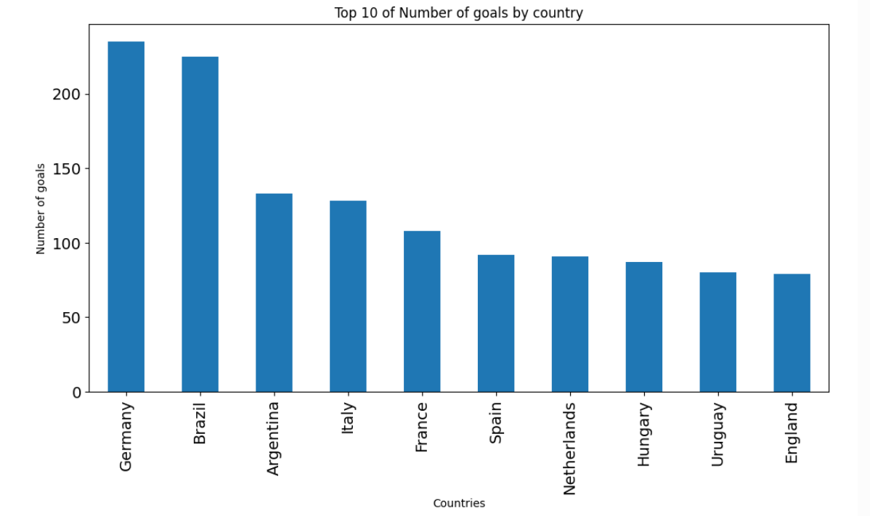
AREAS OF FOCUS
TOP 10 GOALS BY COUNTRY BY COUNT

Slide 7
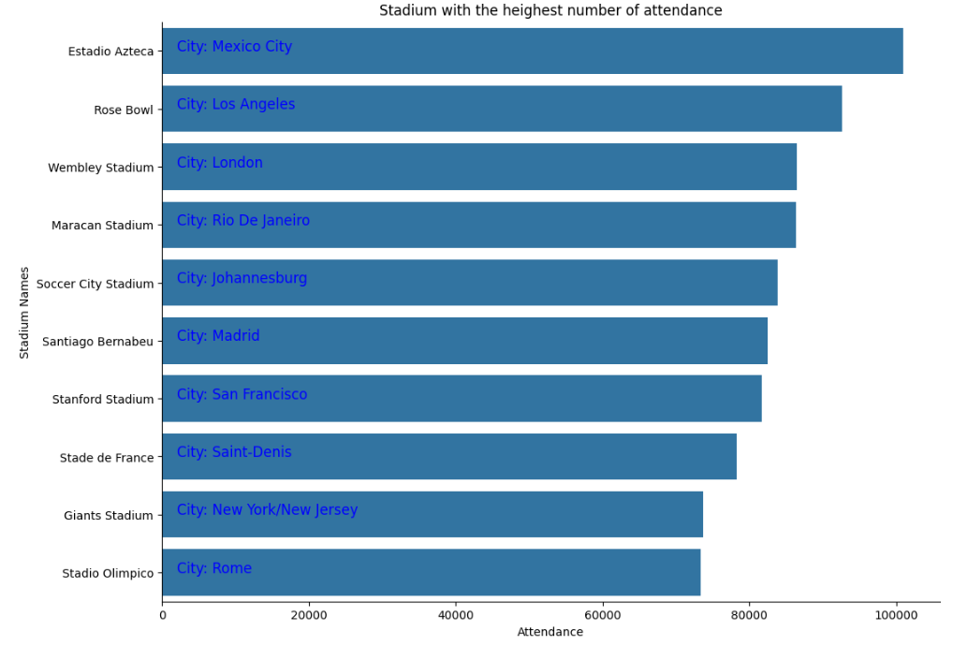
ATTENDANCE

Slide 8
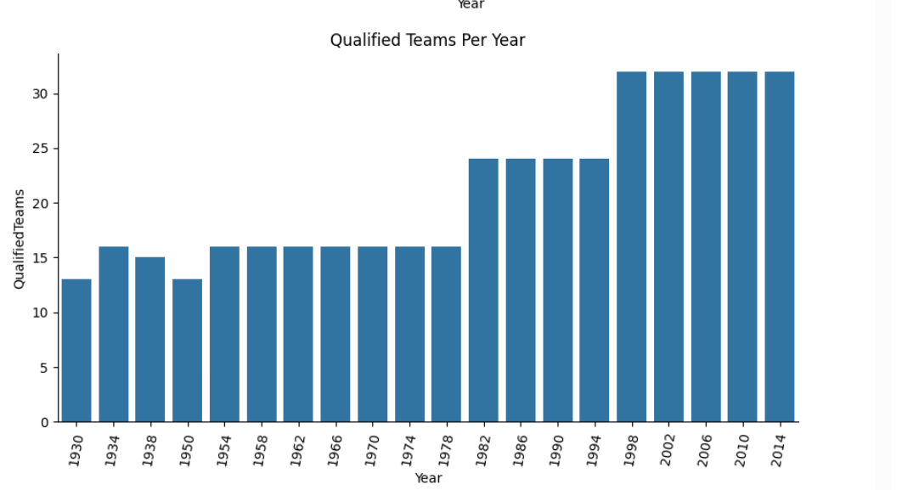
Qualified teams

Slide 9
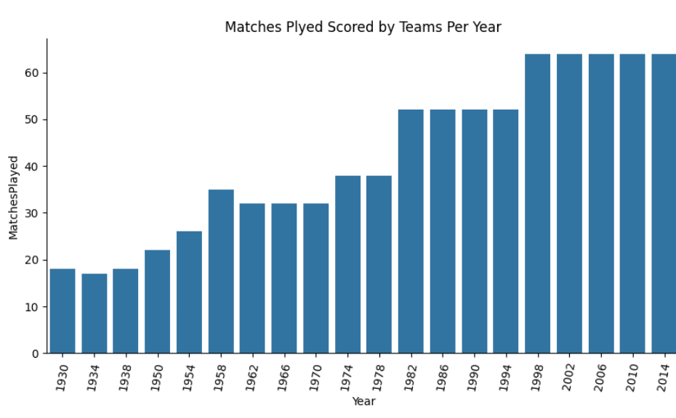
Matches played by team

Slide 10
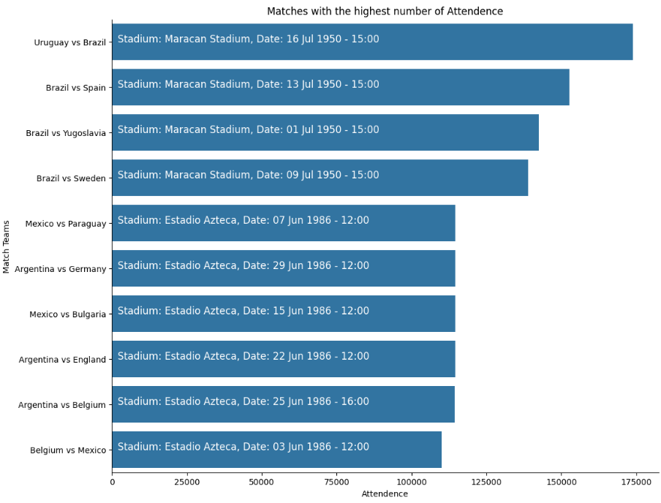
HIGHEST MATCHES ATTENDENCE

Slide 11
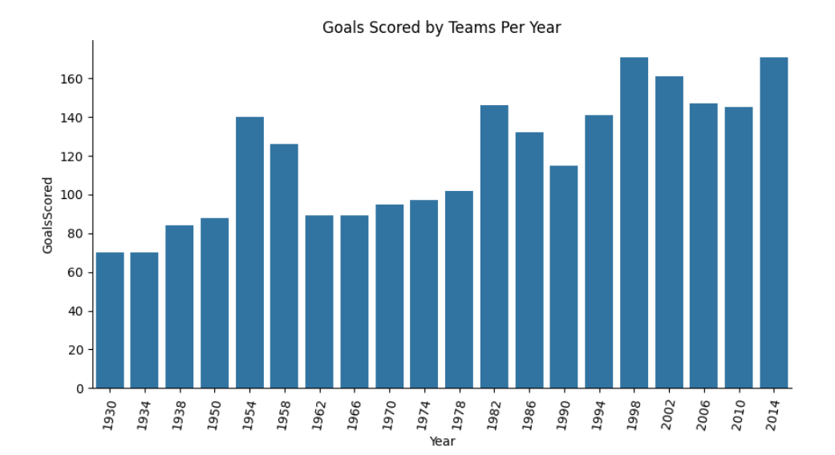
Goals scored by teams
1998 and 2014

Slide 12
THANK YOU
Fiza Fahameen M
fizafahameen@gmail.com

